Slide 1
(CFS) Cloud Native Developer
Case Study on Azure Native Development Solution
24 Sep 2021
Pranav Mistry (632487)

Slide 2
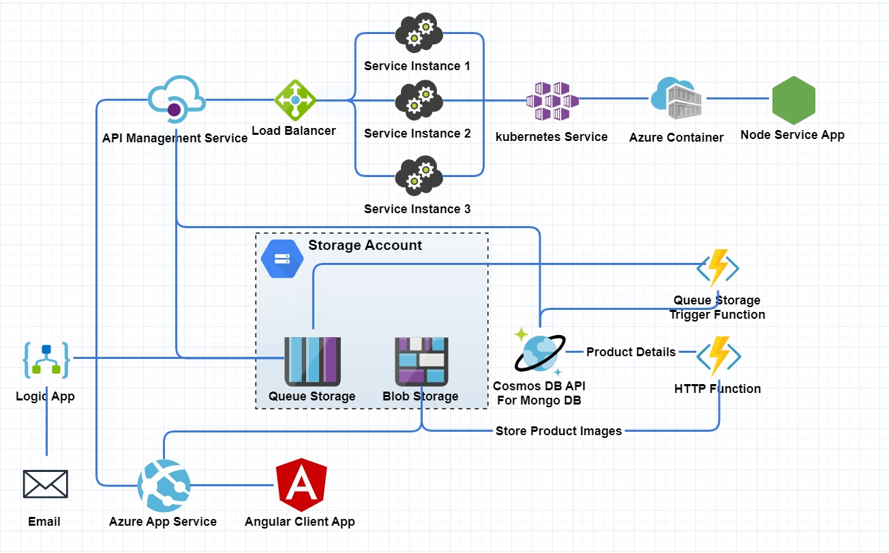
Application Flow

Slide 3

Application Implementation Requirement
Organic Store Application Development:
Cosmos DB Database: Create Cosmos DB App in Azure to store
Create Cosmos DB app in Azure.
Create Collection and Import data.
Static Image Storage: Create Blob Storage in Azure to store static image files.
Create Storage Account in Azure.
Create Container to store Application specific images.
Organic eCom Website - Developed in Angular and hosted on Azure App Service
Add code to Azure DevOps project.
Add references to Blob Storage describe in below requirement.
Add references to Node API describe in below requirement.
Create Pipeline Agent on Linux VM, configure, link and start agent from Azure DevOps.
Create Azure Pipeline to deploy application code to Azure App Service.

Slide 4
Application Implementation Requirement:
Organic App Service: Developed in NodeJS and hosted on Kubernetes through Azure Container Service.
Add code to Azure DevOps project.
Add references to Cosmos DB describe in below requirement.
Create Dockerfile with required settings and ENV variable to connect to Queue Storage.
Create Azure Pipeline to deploy application code to Azure Kubernetes Service and Azure Container Repository.
Azure HTTP Function: Developed Azure HTTP Function to get all product details from MongoDB and store product details to MongoDB in Azure and Blob Storage.
Create Azure Function APP.
Create Azure HTTP Function which accepts GET call and connects to CosmosDB API for MongoDB.
In same Azure function add POST call to connect to Blob Storage and Cosmos DB.
Save application code to Azure Repository.

Slide 5
Application Implementation Requirement:
Azure Queue Storage Trigger: When new complaint received in Queue Storage trigger Queue Storage Function and update Cosmos DB collection by updating complaint count.
Create Azure Queue Storage Trigger Function.
Add connection to Storage Queue so that function can get triggered value.
Add connection to CosmosDB collection to update complaint count.
Add code to read message value, search record in CosmosDB and update complaint count for that product id.
Azure Logic App: Develop Azure Logic App to send Email once (complaint) message received in Azure Queue Storage.
Create Azure Logic App.
Add workflow which included Queue Storage trigger with its Application Key and settings.
Add action to send Email with option which includes received message details like ID, Message content etc.. In Email body.
After sending Email add action to delete received message from Storage Queue.

Slide 6

Pending Items:
Azure API Management: In progress

Slide 7
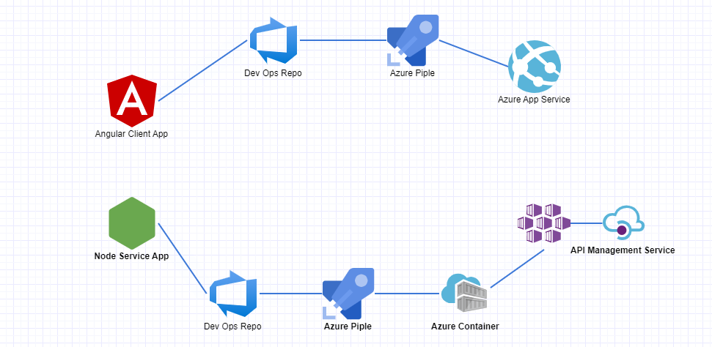
Application Deployment Flow

Slide 8

Execution Step and Images:
Please refer below documents for execution steps and code.
Links:
Organic Client APP (Angular App):
https://github.com/PranavMistry1987/organic-client
Organic API (NodeJS App):
https://github.com/PranavMistry1987/organic-service
Organic Function App:
https://github.com/PranavMistry1987/organic-FunctionApp
Execution Steps and Documentation:
https://github.com/PranavMistry1987/OrganicAppDocumentation

